Slide 1

E-lock Pitch Deck
14th November, 2019

Slide 2

SMART PACKAGING
Security Advancement
SMART. ANTI -THEFT. SECURE SOLUTION

Slide 3
AGENDA
Existing Security Systems
Problem Statement
Proposed Solution
Audience Study
Functionality Log

Slide 4


Existing Packaging Security System
SEAL TAPES | HOLOGRAM | PLASTIC TAGS
Tamper-evident seals have an important role to play in customs, nonproliferation,
law enforcement.
Unfortunately, the tamper-indicating seals currently available, given how they are typically used, can be quickly and easily spoofed by almost anyone.

Slide 5



MAJOR PROBLEMS WITH CURRENT SYSTEM
1
2
3
The Material (intransit)
can be damaged/replaced.
More chances of
unauthorized access
to the boxes.
The items are prone to theft/ misplacement.

Slide 6

MAJOR PROBLEMS WITH CURRENT SYSTEM
1
2
3
The Material (intransit)
can be damaged/replaced.
More chances of
unauthorized access
to the boxes.
4
The items are prone to theft/ misplacement.
Less Reliability and more risk factors involved.

Slide 7

MAJOR PROBLEMS WITH CURRENT SYSTEM
1
2
3
The Material (intransit)
can be damaged/replaced.
More chances of
unauthorized access
to the boxes.
4
5
The items are prone to theft/ misplacement.
Challenges the security
of material.
Less Reliability and more risk factors involved.

Slide 8

OUR PROPOSED SOLUTION

Slide 9



OUR PROPOSED SOLUTION
Security Development
We aim to benefit our clients by providing a robust locking system for the boxes which enhance the security of their materials, thereby increasing the reliability

Slide 10

OUR PROPOSED SOLUTION
Security Development
A Low Power Bluetooth based locking system for boxes of any size and
shape.

Slide 11
HOW IT BENEFITS

Slide 12



Prevents the unauthorized access - Unlocking box using the client’s mobile
application ie SDK embedded with Amazon/ Flipkart or any other clients.
Prevents any sort of tampering with the material in transit - The box unlocking
can happen at pre-defined geo-location. (at customer delivery location and only)
By the customer and authorized receiver.
Reduce unnecessary packaging cost ie No need to use tamper-evident envelopes,
bubble wrap etc anymore.

Slide 13
Who Got Benefited
1
End Customers
2
The Company Management
3
Store Owners
4
Vendors

Slide 14
Functionality

Slide 15


FUNCTIONALITY
Locking and Unlocking
Locking and unlocking by authorized user only
Organization can have Admin & multiple Sub-Admin.
Sub- Admin or temporary-Admin are those, who can access box for some specific time period ie for 1 day or any ‘x’ days and after ‘x’ days time limit automatically system remove sub-admin.
Eg Customer can be Sub-Admin for two days ( or till the delivery time)
Offline unlocking : We can have functionality to open lock in no network zone as well ( using
offline mobile app or using OTP ) and later sync-up with server once get data connectivity
Log
Keep record of authorized and unauthorized attempt

Slide 16

FUNCTIONALITY
Geo Fencing
Set Geolocation For UnLocking
Admin can dynamically change geofencing location for accessing or Opening and using
Pre-defined Geo- location where the box can be accessed.

Slide 17





FUNCTIONALITY
Find me
Search and find any particular box using
Bluetooth- proximity profile
To find box in inventory/warehouse using mobile app it will give
direction in app and Box buzzer will make sound.
BLUETOOTH LOW ENERGY SENSOR NODES

Slide 18





FUNCTIONALITY
GPS Tracking
Tracing of the box using employee mobile phone
Application - live location
In transit, Admin can track GPS live
location of box while employee mobile
is connected with box bluetooth.

Slide 19
Integration

Slide 20

ORDERS
SHIPMENTS
TRACKING
ERP
INVENTORY
PRODUCT DATA
Integrate e-lock dashboard with your ERP

Slide 21

Integrate e-lock SDK with your Mobile Application

Slide 22
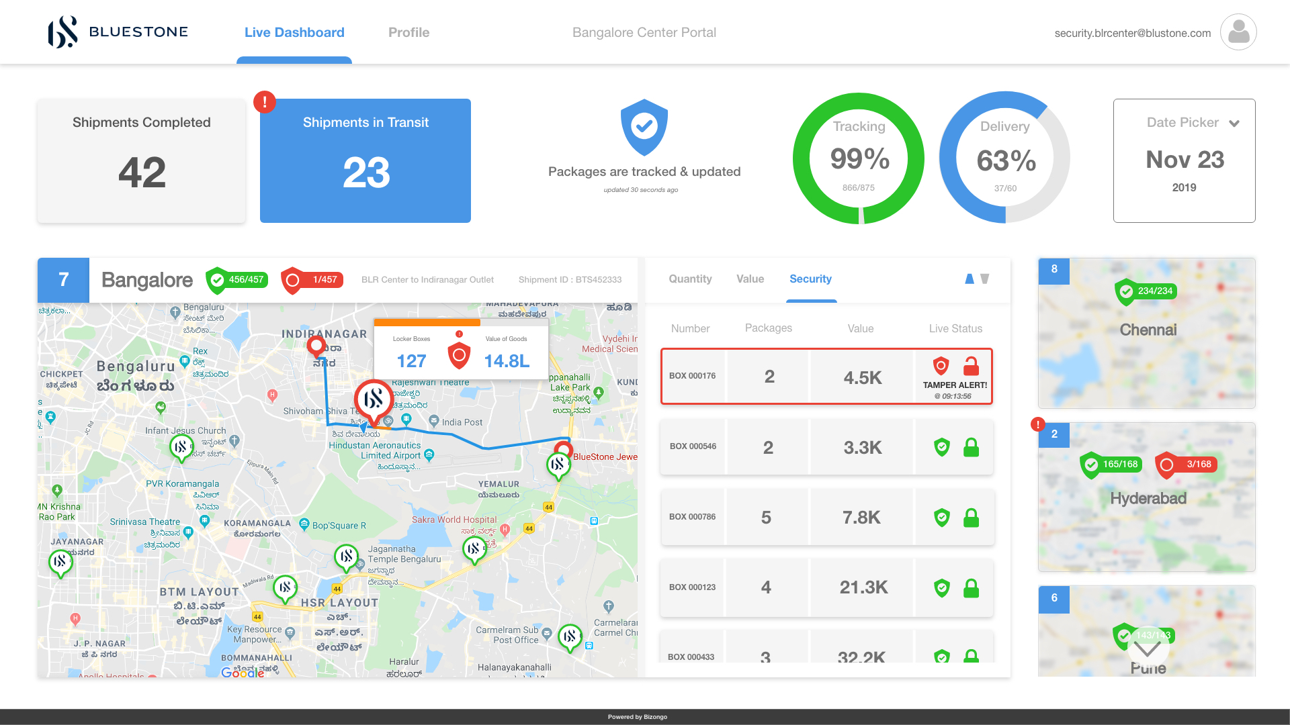
DASHBOARD

Slide 23
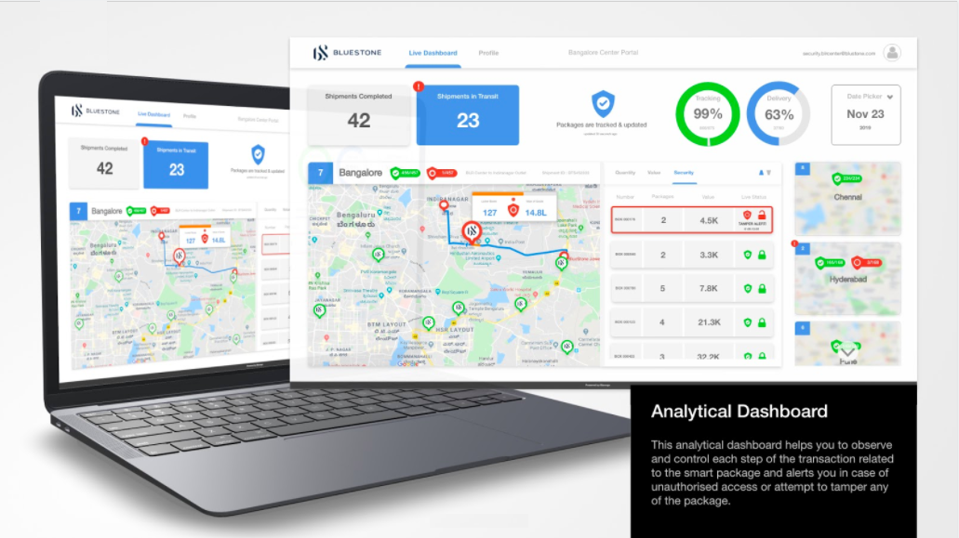

Slide 24

OUR PROPOSED SOLUTION
SMART PACKAGING

